Slide 1
Learning Sparse Low-Threshold Linear Classifiers
Zejian Zhan

Slide 2

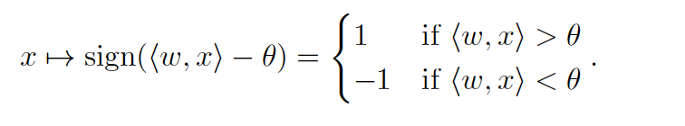
What does the title mean?
Why do we use l₁ norm here?
Sparsity
The challenge is how complexity of learning H_{k, θ} changes with θ
Notes:
We associate linear predictor in H with a binary classifier

Slide 3

Winnow online learning
can be seen as a generalization and extension of the class of k-monotone(No negations)-disjunctions(θ = 1/2) and r-or-k-formulas(θ = r-1/2).
Maintains hypothesis as a linear threshold function.
Update: On false positive, i.e. u(x)=0 and h(x)=1, we update:
On false negatives, i.e. u(x)=1 and h(x)=0, we update

Slide 4
Mistake bound of Winnow
O(klogd) for k-disjunctions and O(rklogd) for r-of-k formulas
O(θklogd) for H_{k, θ} with real-valued weights

Slide 5

What if the instances x can also be fractional?
x [0,1]^{d} and in the non-separable case
Clarify loss function for fractional analysis and consider separation with margin for agnostic analysis
For explicit margin, we’ll rely on the hinge loss at margin half for both in online learning and statistical learning

Slide 6
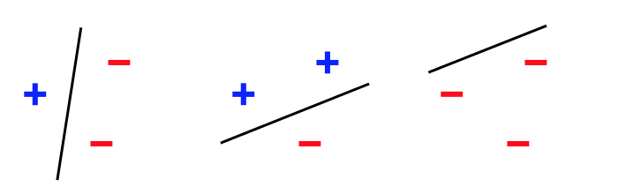
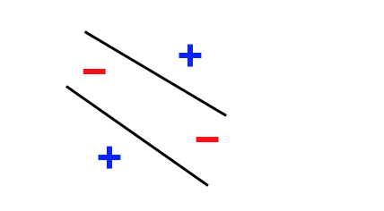
Linear separability

Slide 7

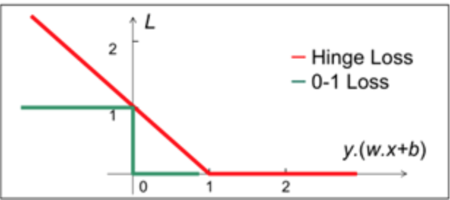
Hinge loss

Slide 8
Approaches can be used
For online setting, Online Exponentiated Gradient can be used and it relies only on l₁-bound
For statistical setting, Empirical Risk Minimization can be used to minimize the empirical hinge loss and also relies only on l₁-bound

Slide 9
Exponentiated Gradient
For the GD algorithm, the update is based on subtracting the gradient of the squared error made on a prediction.
The EG algorithm uses the components of the gradient in the exponents of factors that are used in updating the weight vector multiplicatively.

Slide 10
ERM(Empirical Risk Minimization)
Assume that there is a joint probability distribution over x, y
We can derive loss functions and risk functions which is the expectation of loss functions
Can we compute R?
Compute approximation empirical risk by averaging the loss function on the training set

Slide 11
The bound isn’t consistent
These approaches yield mistake bounds or sample complexity with k²
When θ is nearly k/2, Winnow bound agrees with EG bound. But if θ is 1/2, Winnow will yield bound of k rather than k².
The gap is the starting point and the motivation of this paper
Notes:
sample complexity of a machine learning algorithm is, roughly speaking, the number of training samples needed for the algorithm to successfully learn a target function. More specifically, the sample complexity is the number of samples needed for the function returned by the algorithm to be within an arbitrarily small error of the best possible function, with probability arbitrarily close to 1

Slide 12
Achievements of this paper
Providing a variant EG, which establishes a regret bound and is better than that of standard EG analysis.
ERM Upper Bound
Lower Bound

Slide 13
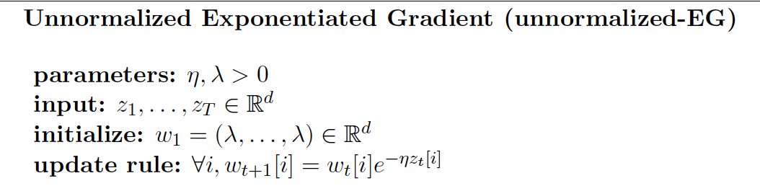
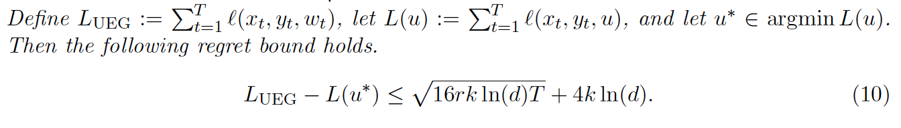


Unnormalized Exponentiated Gradient
For online setting
For statistical setting

Slide 14

Regret
Definition: the regret at time T is the difference between the loss incurred up to T by the algorithm and that of the best expert in hindsight:
Notes:
LTmin = mini LTi

Slide 15

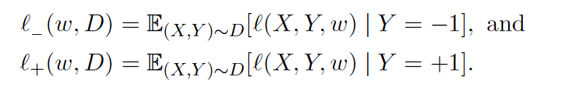
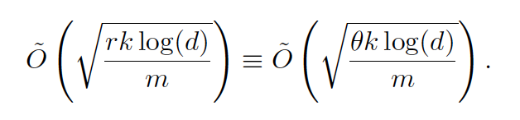
ERM Upper Bound
Show the upper bound on
Consider the loss on negative and positive examples separately
Uniform convergence analysis for negative labels cannot provide a tight result, and thus using Rademacer complexity to lead to a uniform convergence guarantee.
Notes:
measures richness of a class of real-valued functions with respect to a probability distribution

Slide 16
Lower Bound
Lower bound for learning rate is theta k
Show that Uniform Convergence Lower Bound is
which is slower than proposed in Upper bound part.

Slide 17
Conclusion
Convert to k-monotone disjunctions and r-of-k-formulas problem and introduce Winnow
Explore possible algorithm EG and ERM when x is also fractional.
After observing the inconsistent mistake bound, a variant EG algorithm is proposed and regret bound is proved
Prove the Upper bound for ERM and show that uniform convergence will yield slower lower bound

